Slide 1

Logical Design
Lecture 6
UECS 1203
DATABASE SYSTEM FUNDAMENTALS

Slide 2
Step 2 Build and Validate Local Logical Data Model
To build a local logical data model from a local conceptual data model representing a particular view of the enterprise, and then to validate this model to ensure it is structurally correct (using the technique of normalization) and to ensure it supports the required transactions.

Slide 3
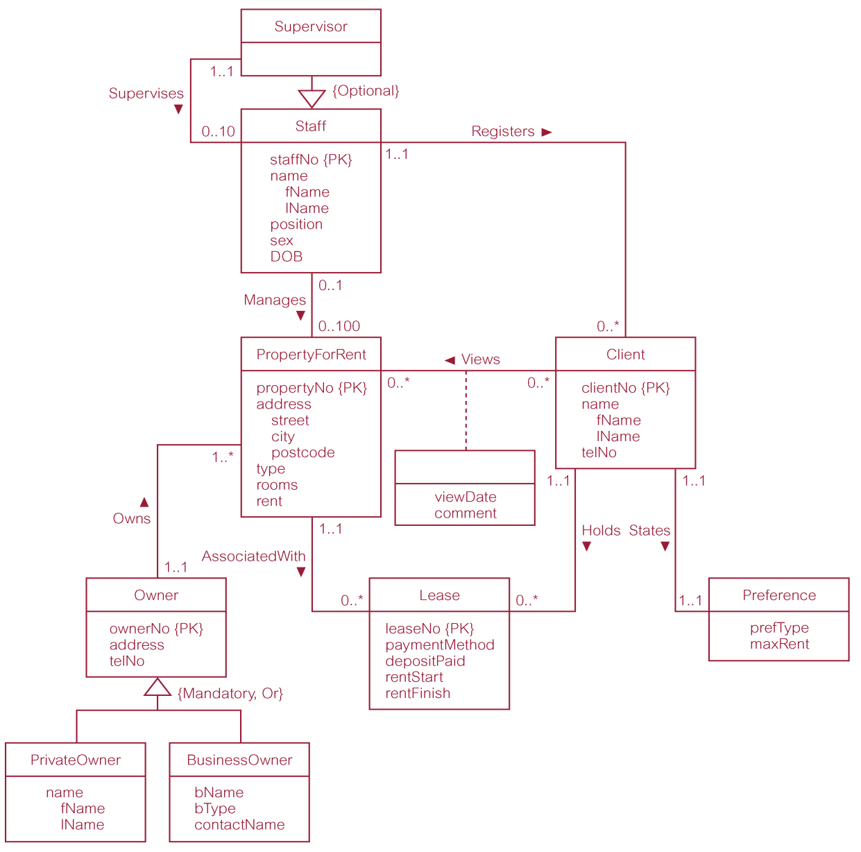
Local conceptual data model for Staff view showing all attributes

Slide 4
Step 2 Build and Validate Local Logical Data Model
Step 2.1 Remove features not compatible with the relational model (optional step)
To refine the local conceptual data model to remove features that are not compatible with the relational model. This involves:
  remove *:* binary relationship types;
  remove *:* recursive relationship types;
  remove complex relationship types;
  remove multi-valued attributes.

Slide 5
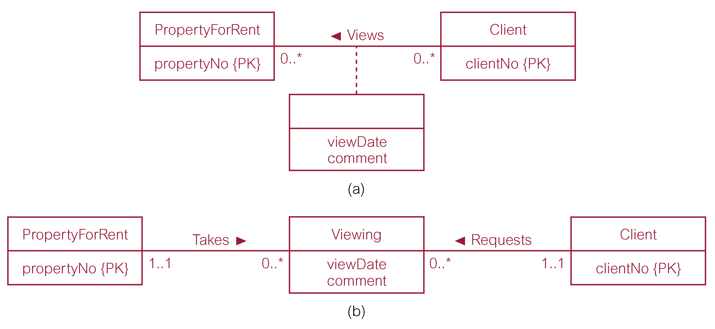
Remove *:* binary relationship types

Slide 6
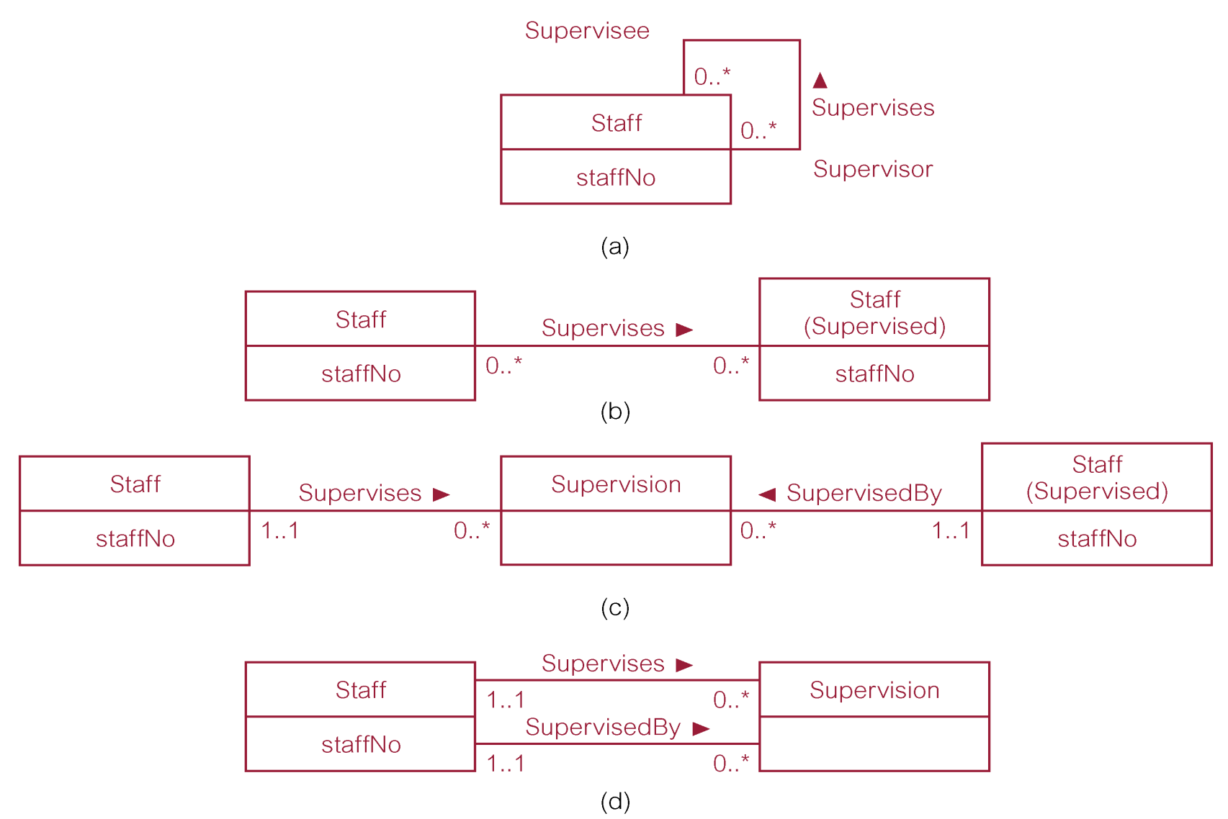
Remove *:* recursive relationship types

Slide 7
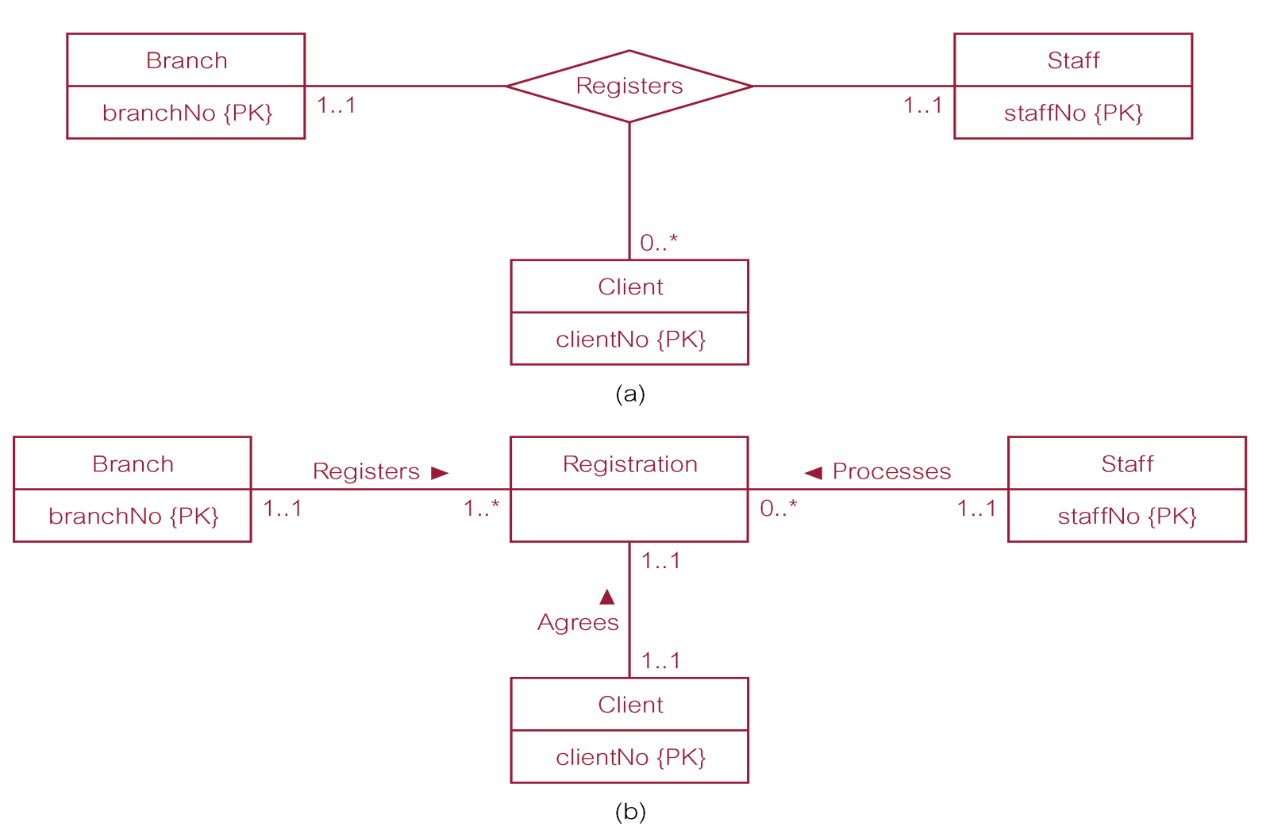
Remove complex relationship types

Slide 8
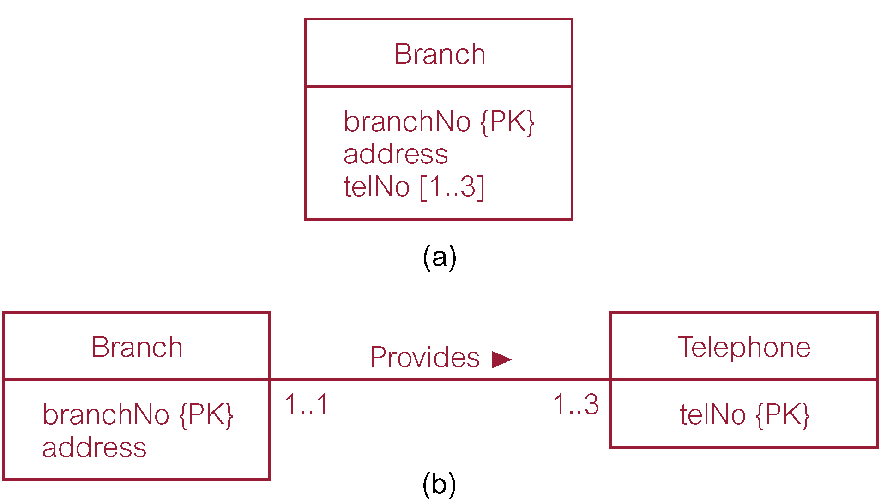
Remove multi-valued attributes

Slide 9
Step 2 Build and Validate Local Logical Data Model
Step 2.2 Derive relations for local logical data model
  To create relations for the local logical data model to represent the entities, relationships, and attributes that have been identified.

Slide 10
Step 2.2 Derive relations for local logical data model
(1) Strong entity types
  Create a relation that includes all simple attributes of that entity. For composite attributes, include only constituent simple attributes.
Staff (staffNo, fName, lName, position, sex, DOB)
  Primary Key staffNo

Slide 11
Step 2.2 Derive relations for local logical data model
(2) Weak entity types
  Create a relation that includes all simple attributes of that entity.
  Primary key is partially or fully derived from each owner entity.
Preference (prefType, maxRent)
  Primary Key None (at present)

Slide 12
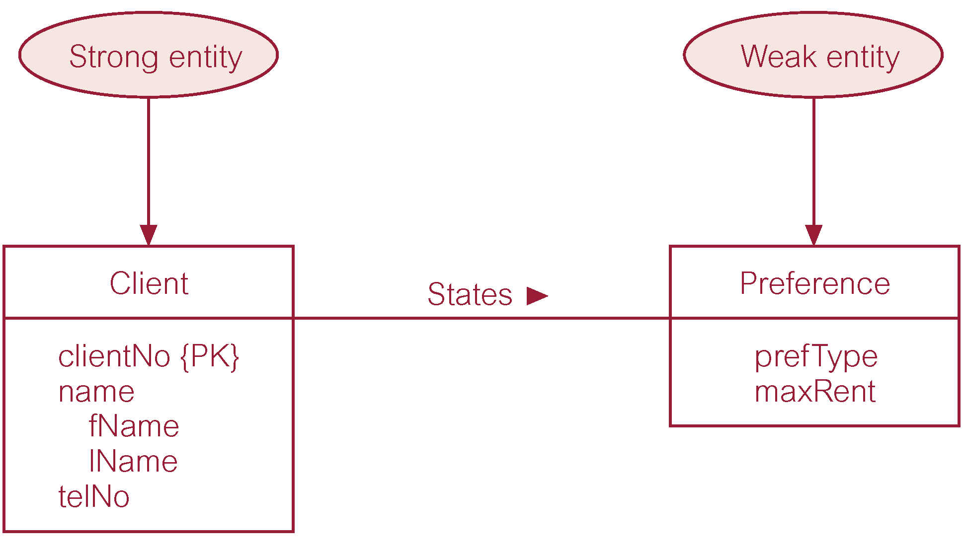
Strong entity type called Client and weak entity type called Preference

Slide 13
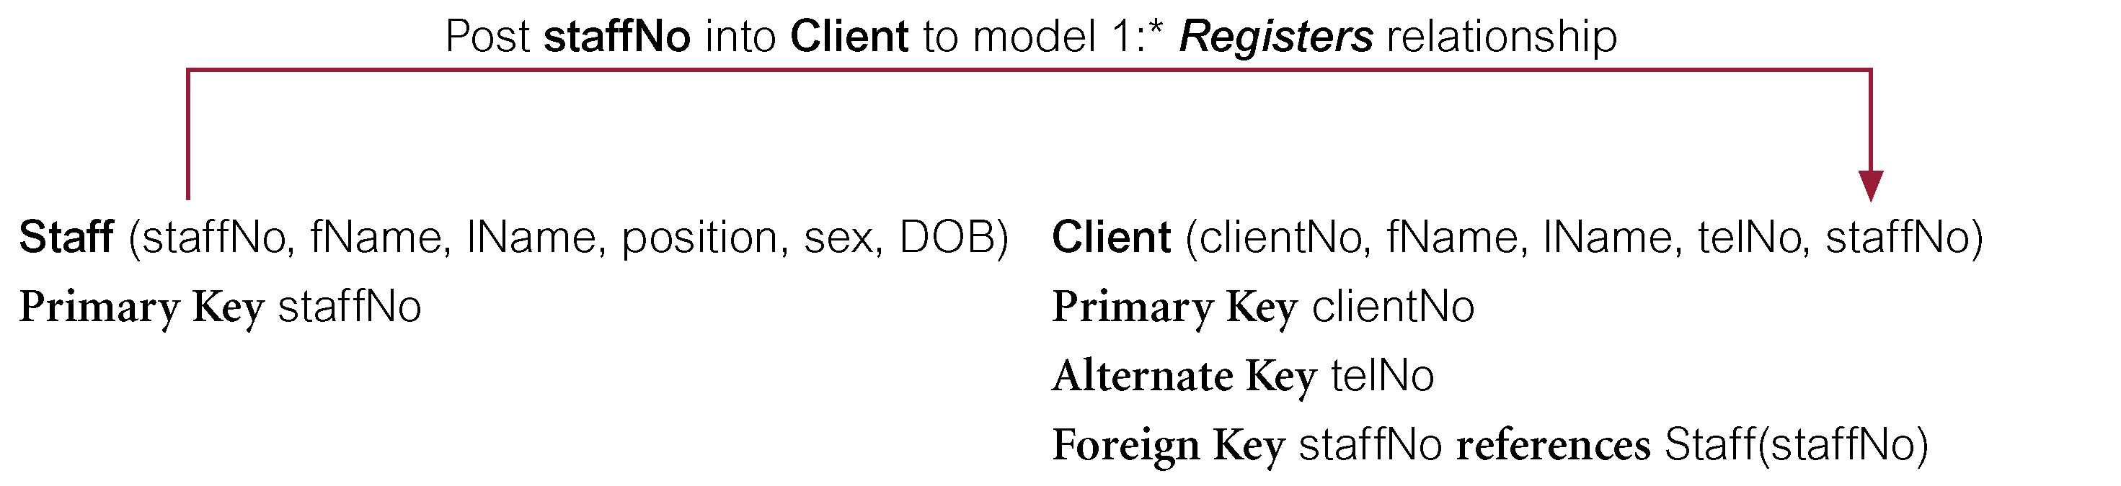
Step 2.2 Derive relations for local logical data model
(3) 1:* binary relationship types
  Entity on ‘one side’ is designated the parent entity and entity on ‘many side’ is the child entity.
  Post copy of the primary key attribute(s) of parent entity into relation representing child entity, to act as a foreign key.

Slide 14
Step 2.2 Derive relations for local logical data model
(4) 1:1 binary relationship types
  More complex as cardinality cannot be used to identify parent and child entities in a relationship.
  Instead, participation used to decide whether to combine entities into one relation or to create two relations and post copy of primary key from one relation to the other. Consider following:
  (a) mandatory participation on both sides of 1:1 relationship;
  (b) mandatory participation on one side of 1:1 relationship;
  (c) optional participation on both sides of 1:1 relationship.

Slide 15
Step 2.2 Derive relations for local logical data model
(a) Mandatory participation on both sides of 1:1 relationship
  Combine entities involved into one relation and choose one of the primary keys of original entities to be primary key of new relation, while other (if one exists) is used as an alternate key.
Client (clientNo, fName, lName, telNo, prefType,
  maxRent, staffNo)
  Primary Key clientNo
  Foreign Key staffNo references Staff(staffNo)

Slide 16
Step 2.2 Derive relations for local logical data model
(b) Mandatory participation on one side of a 1:1 relationship
  Identify parent and child entities using participation constraints.
  Entity with optional participation is designated parent entity, and other entity designated child entity.
  Copy of primary key of parent placed in relation representing child entity.
  If relationship has one or more attributes, these attributes should follow the posting of the primary key to the child relation.

Slide 17
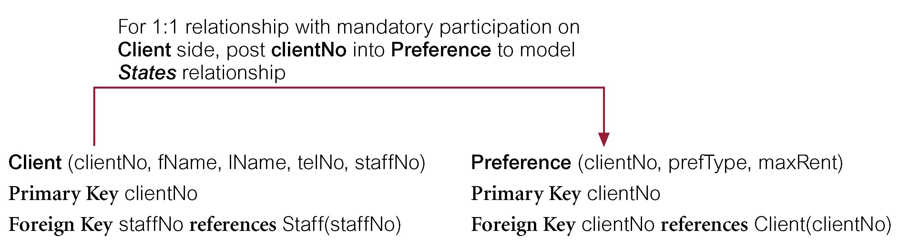
Step 2.2 Derive relations for local logical data model
(b) Mandatory participation on one side of a 1:1 relationship - Example

Slide 18
Step 2.2 Derive relations for local logical data model
(c) Optional participation on both sides of a 1:1 relationship
  Designation of the parent and child entities is arbitrary unless can find out more about the relationship.
Consider 1:1 Staff Uses Car relationship with optional participation on both sides. Assume majority of cars, but not all, are used by staff and only minority of staff use cars.
Car entity, although optional, is closer to being mandatory than Staff entity. Therefore designate Staff as parent entity and Car as child entity.

Slide 19
Step 2.2 Derive relations for local logical data model
(5) 1:1 recursive relationships - follow rules for participation for a 1:1 relationship.
  mandatory participation on both sides: single relation with two copies of the primary key.
  mandatory participation on only one side: option to create a single relation with two copies of the primary key, or create a new relation to represent the relationship. The new relation would only have two attributes, both copies of the primary key.
  optional participation on both sides, again create a new relation as described above.

Slide 20
Step 2.2 Derive relations for local logical data model
(6) Superclass/subclass relationship types
  Identify superclass as parent entity and subclass entity as child entity.
  There are various options on how to represent such a relationship as one or more relations.
  Most appropriate option dependent on number of factors such as:
    disjointness and participation constraints on the superclass/subclass relationship,
    whether subclasses are involved in distinct relationships,
    number of participants in superclass/subclass relationship.

Slide 21
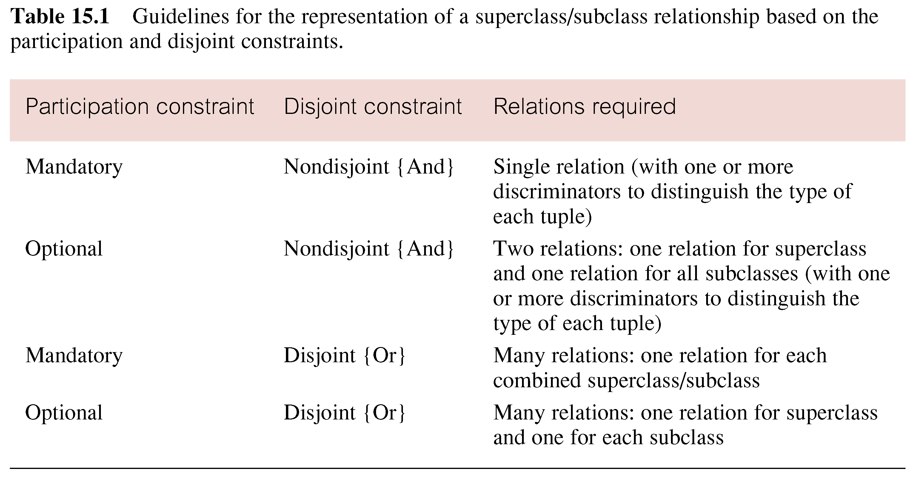
Guidelines for representation of superclass / subclass relationship

Slide 22
Step 2.2 Derive relations for local logical data model
(7) *:* binary relationship types
  Create relation to represent relationship and include any attributes that are part of relationship.
  Post a copy of the primary key attribute(s) of the entities that participate in relationship into new relation, to act as foreign keys.
  These foreign keys will also form primary key of new relation, possibly in combination with some of the attributes of the relationship.

Slide 23
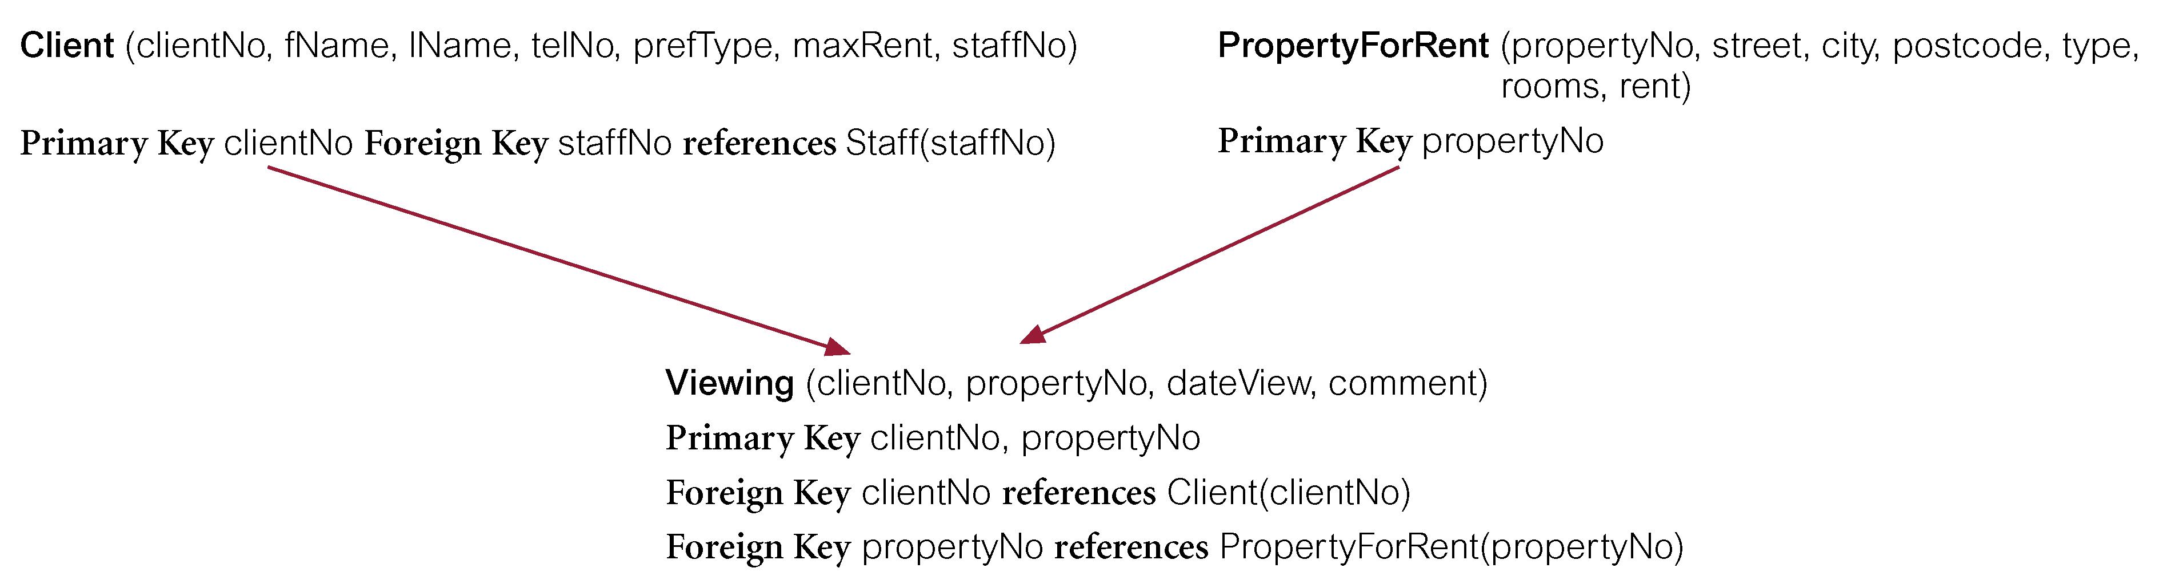
Step 2.2 Derive relations for local logical data model
(7) *:* binary relationship types - Example

Slide 24
Step 2.2 Derive relations for local logical data model
(8) Complex relationship types
  Create relation to represent relationship and include any attributes that are part of the relationship.
  Post copy of primary key attribute(s) of entities that participate in the complex relationship into new relation, to act as foreign keys.
  Any foreign keys that represent a ‘many’ relationship (for example, 1..*, 0..*) generally will also form the primary key of new relation, possibly in combination with some of the attributes of the relationship.

Slide 25
Remove complex relationship types

Slide 26
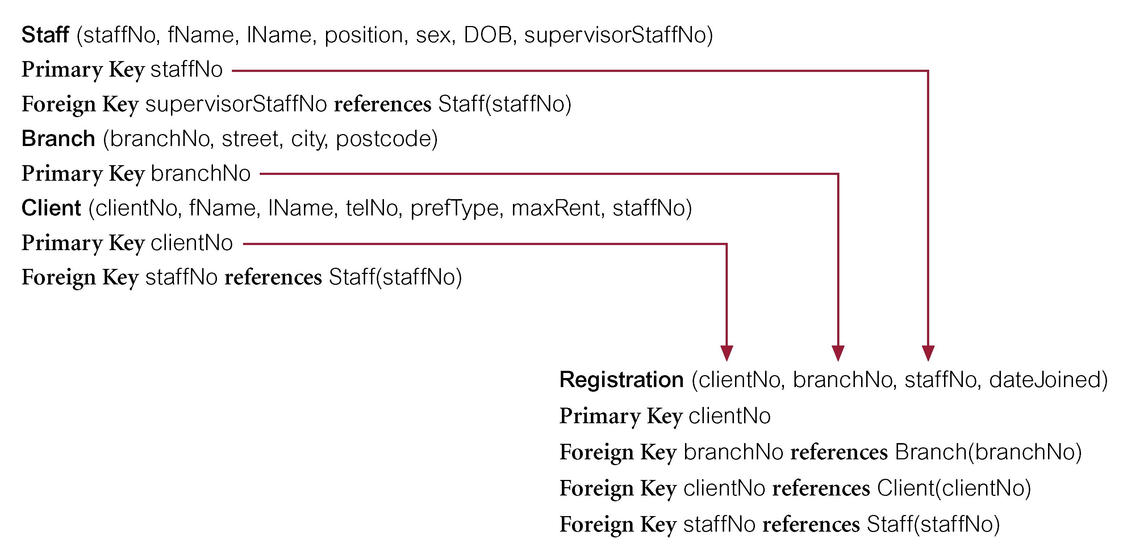
Step 2.2 Derive relations for local logical data model
(8) Complex relationship types - Example

Slide 27
Step 2.2 Derive relations for local logical data model
(9) Multi-valued attributes
  Create new relation to represent multi-valued attribute and include primary key of entity in new relation, to act as a foreign key.
  Unless the multi-valued attribute is itself an alternate key of the entity, primary key of new relation is combination of the multi-valued attribute and the primary key of the entity.

Slide 28
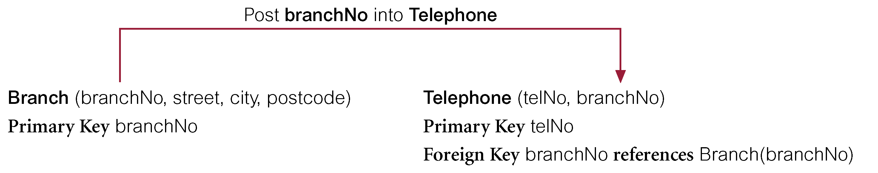
Step 2.2 Derive relations for local logical data model
(9) Multi-valued attributes - Example

Slide 29
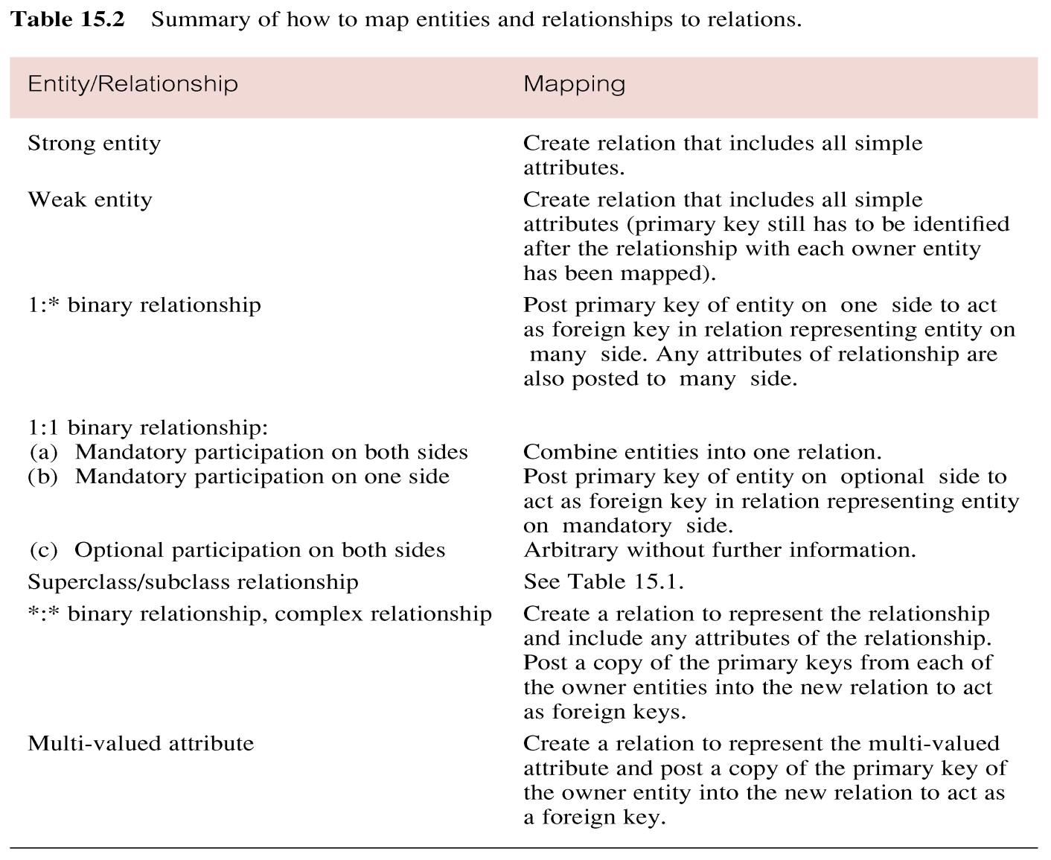
Summary of how to map entities and relationships to relations

Slide 30
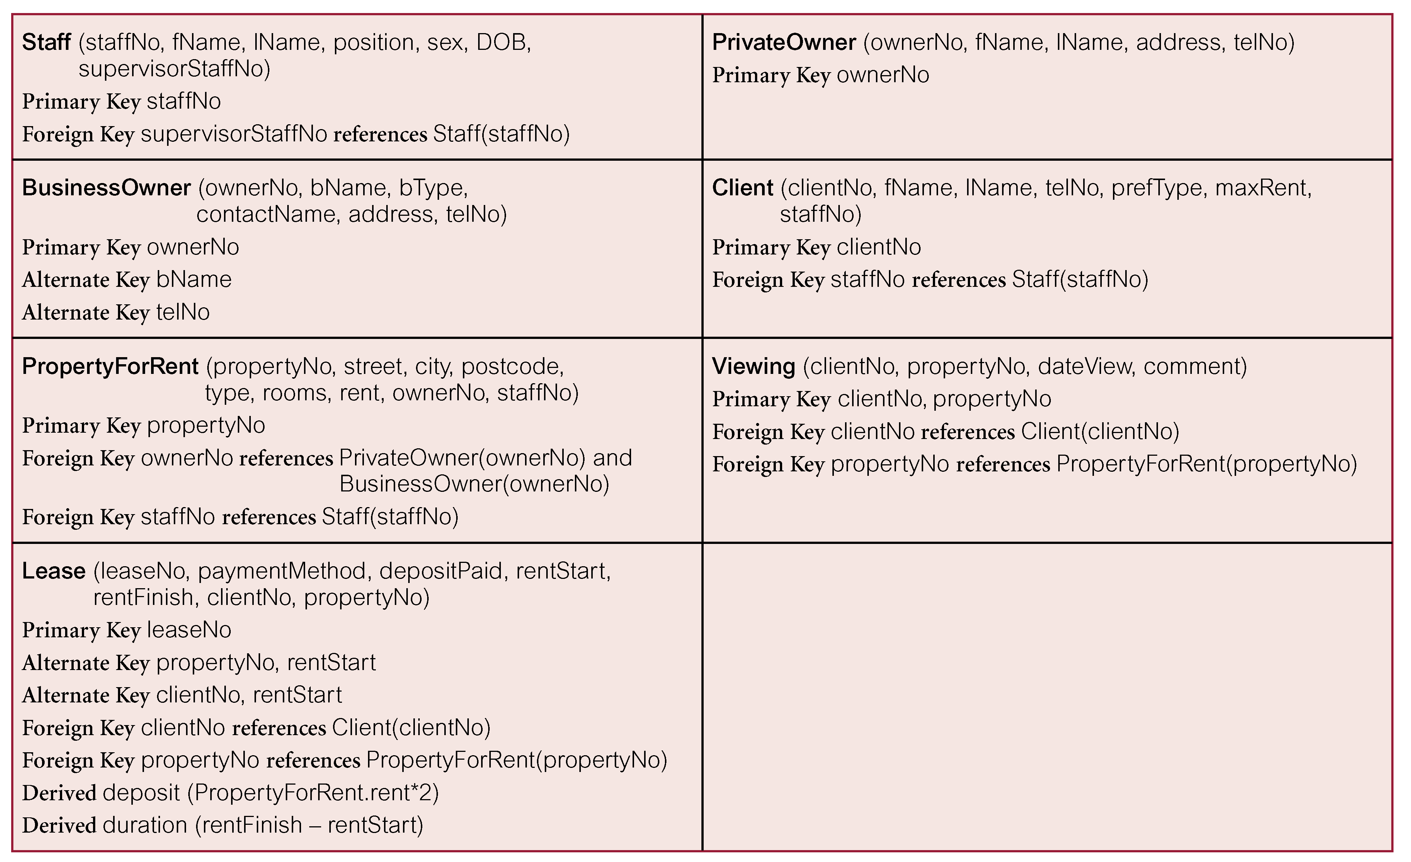
Relations for the Staff view of DreamHome

Slide 31
Step 2 Build and Validate Local Logical Data Model
Step 2.3 Validate relations using normalization
  To validate the relations in the local logical data model using the technique of normalization.
Step 2.4 Validate relations against user transactions
  To ensure that the relations in the local logical data model support the transactions required by the view.
Step 2.5 Define integrity constraints
  To define the integrity constraints given in the view (ie. required data, entity and referential integrity, domains, and enterprise constraints).
  Required data
  Attribute domain constraints
  Entity integrity
  Referential integrity
  Enterprise constraints (document)

Slide 32
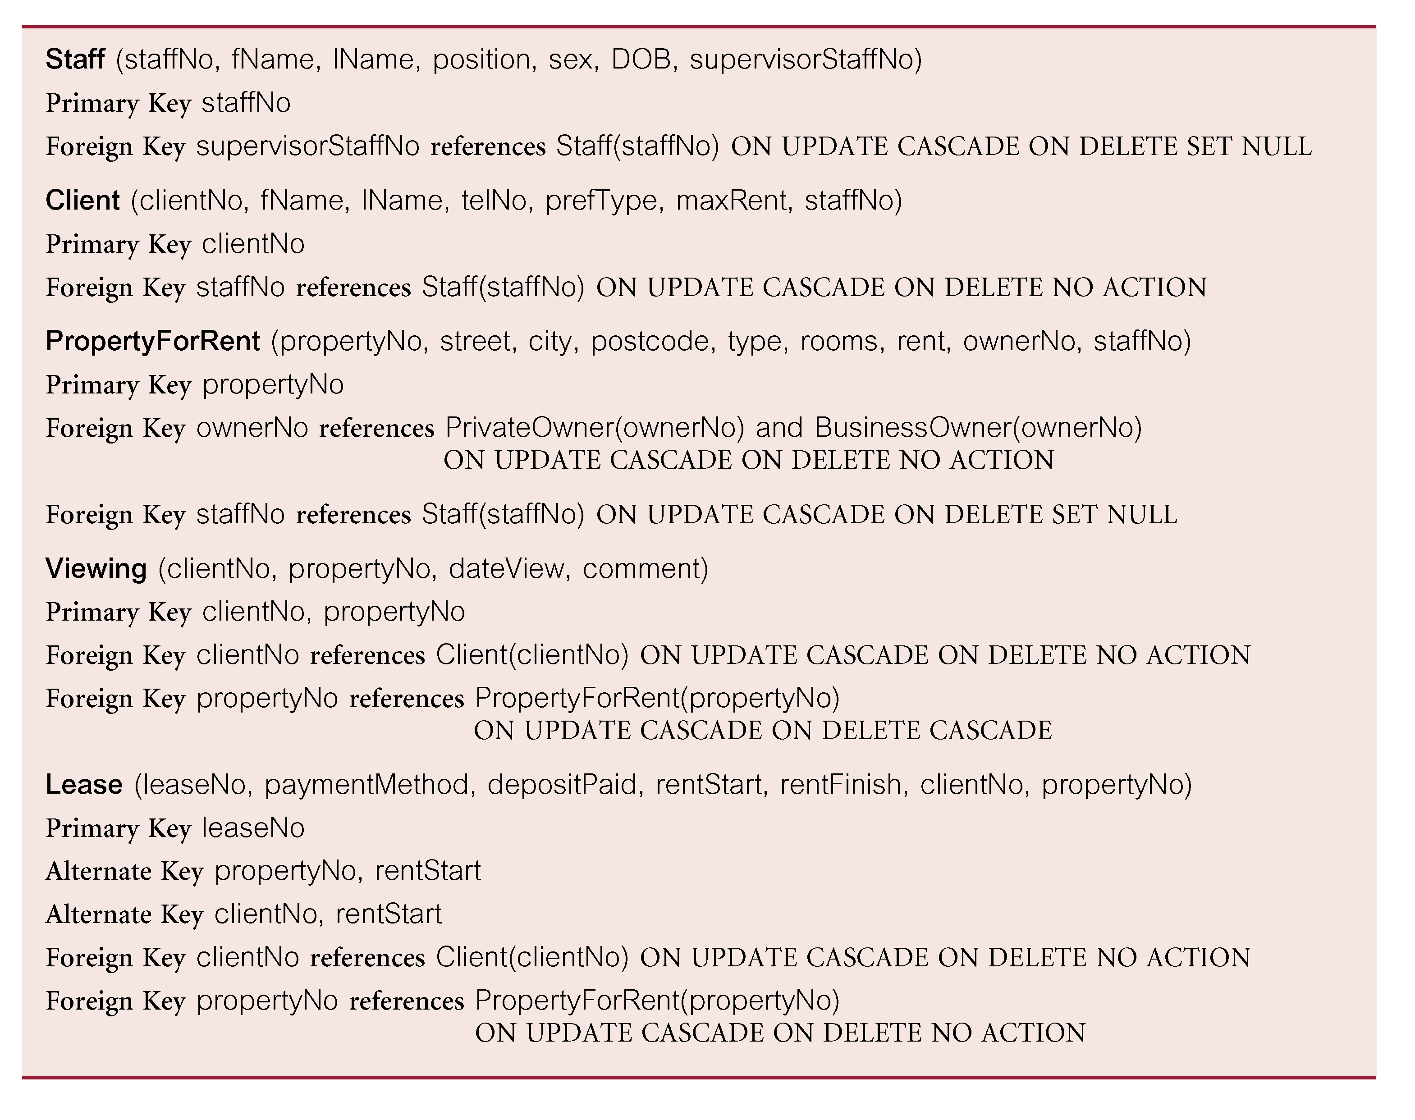
Referential integrity constraints for relations in Staff view of DreamHome

Slide 33
Step 2 Build and Validate Local Logical Data Model
Step 2.6 Review local logical data model with user
  To ensure that the local logical data model and supporting documentation that describes the model is a true representation of the view.

Slide 34
Step 3 Build and Validate Global Logical Data Model
To combine the individual local logical data models into a single global logical data model that represents the enterprise.
Step 3.1 Merge local logical data models into global model
  To merge the individual local logical data models into a single global logical data model of the enterprise.

Slide 35
Step 3 Build and Validate Global Logical Data Model
Typically includes:
  (1) Review the names and contents of entities/relations and their candidate keys.
  (2) Review the names and contents of relationships/foreign keys.
  (3) Merge entities/relations from the local data models
  (4) Include (without merging) entities/relations unique to each local data model
  (5) Merge relationships/foreign keys from the local data models.

Slide 36
Step 3 Build and Validate Global Logical Data Model
  (6) Include (without merging) relationships/foreign keys unique to each local data model.
  (7) Check for missing entities/relations and relationships/foreign keys.
  (8) Check foreign keys.
  (9) Check Integrity Constraints.
  (10) Draw the global ER/relation diagram
  (11) Update the documentation.

Slide 37
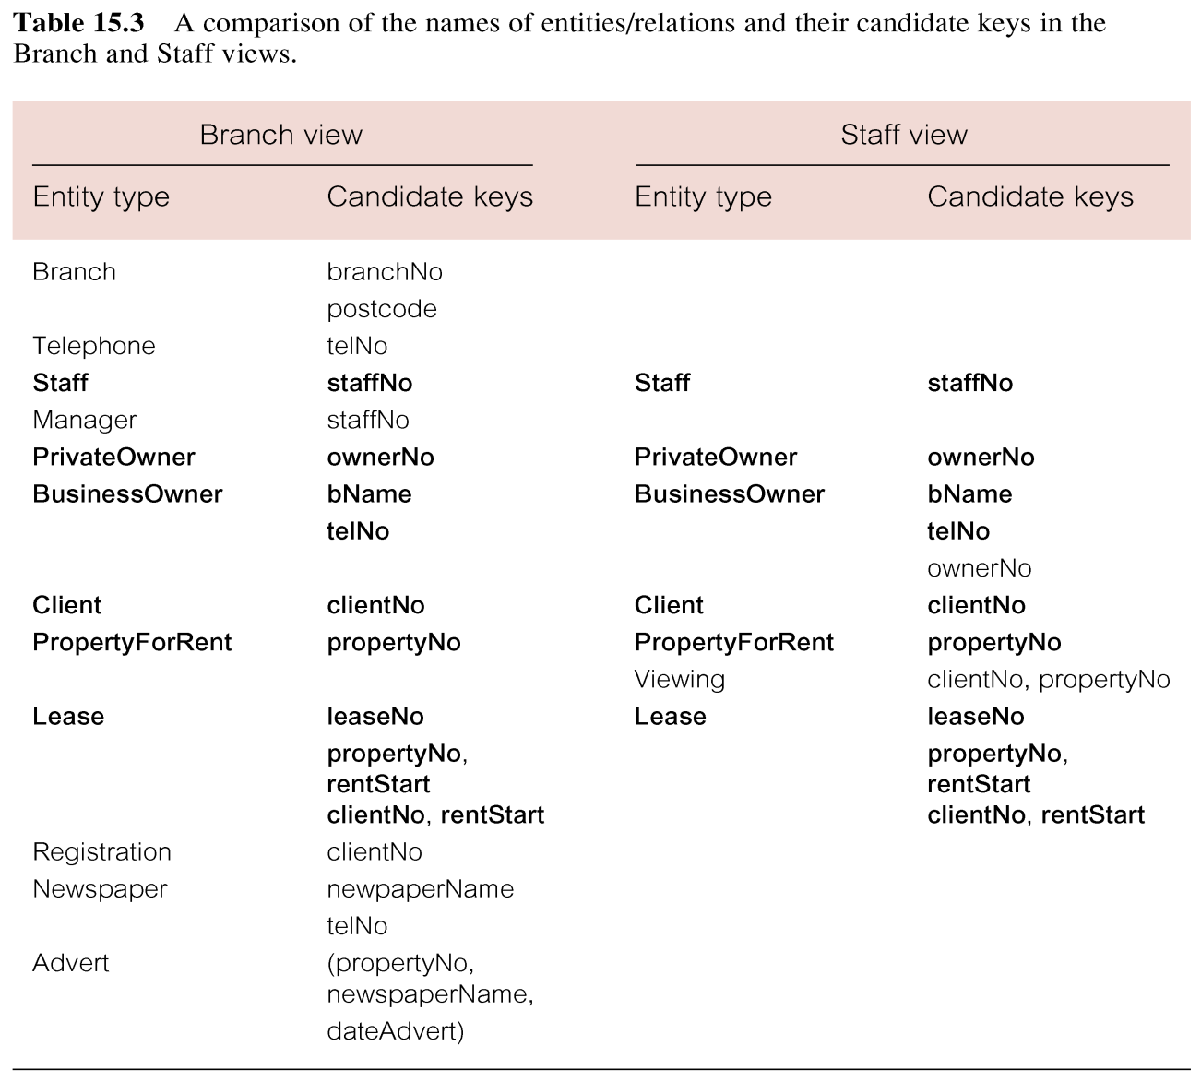
Step 3 Build and Validate Global Logical Data Model

Slide 38
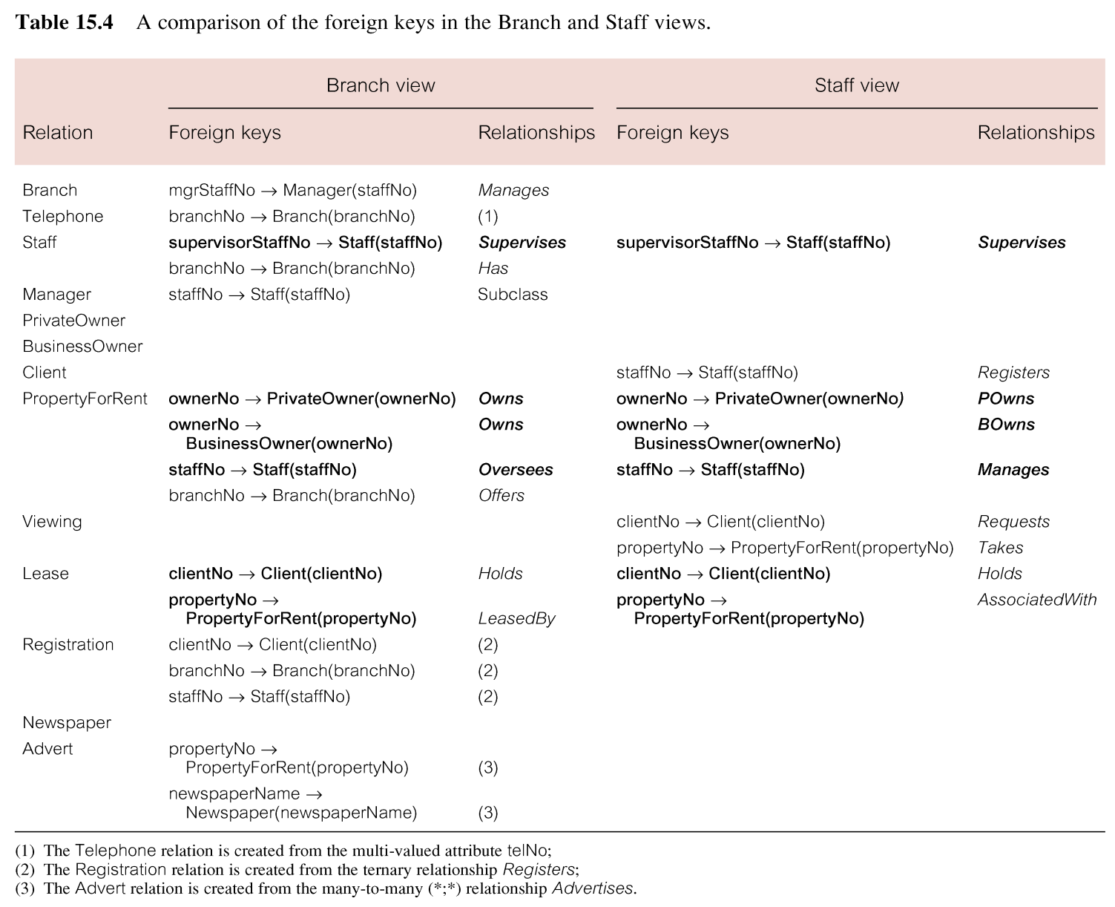
Step 3 Build and Validate Global Logical Data Model

Slide 39
Step 3 Build and Validate Global Logical Data Model
Step 3.2 Validate global logical data model
  To validate the relations created from the global logical data model using the technique of normalization and to ensure they support the required transactions, if necessary.
Step 3.3 Check for future growth
  To determine whether there are any significant changes likely in the foreseeable future and to assess whether the global logical data model can accommodate these changes.

Slide 40
Step 3 Build and Validate Global Logical Data Model
Step 3.4 Review global logical data model with users
  To ensure that the global logical data model is a true representation of the enterprise.

Slide 41
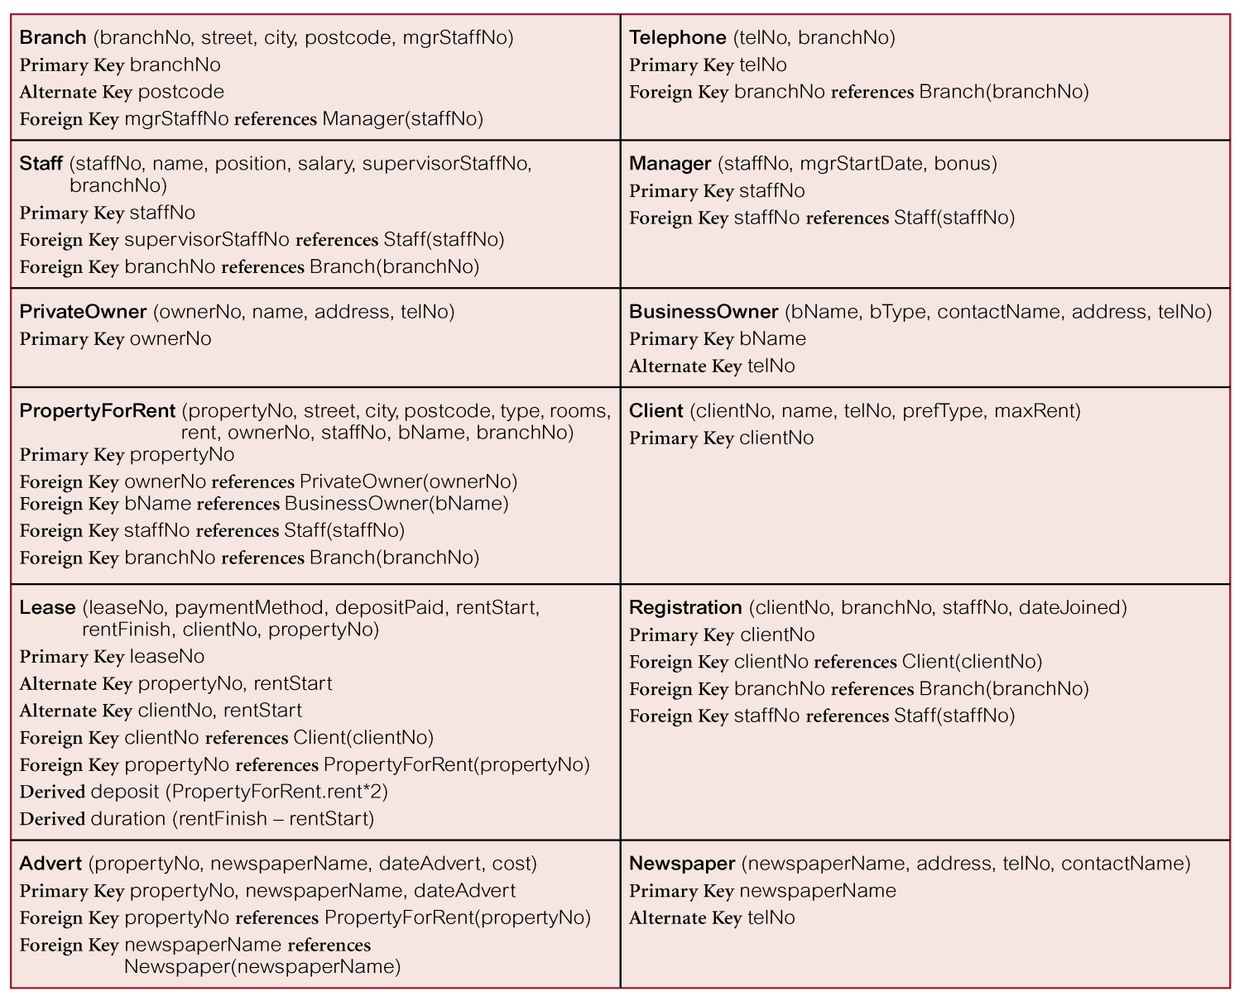
Relations for the Branch view of DreamHome

Slide 42
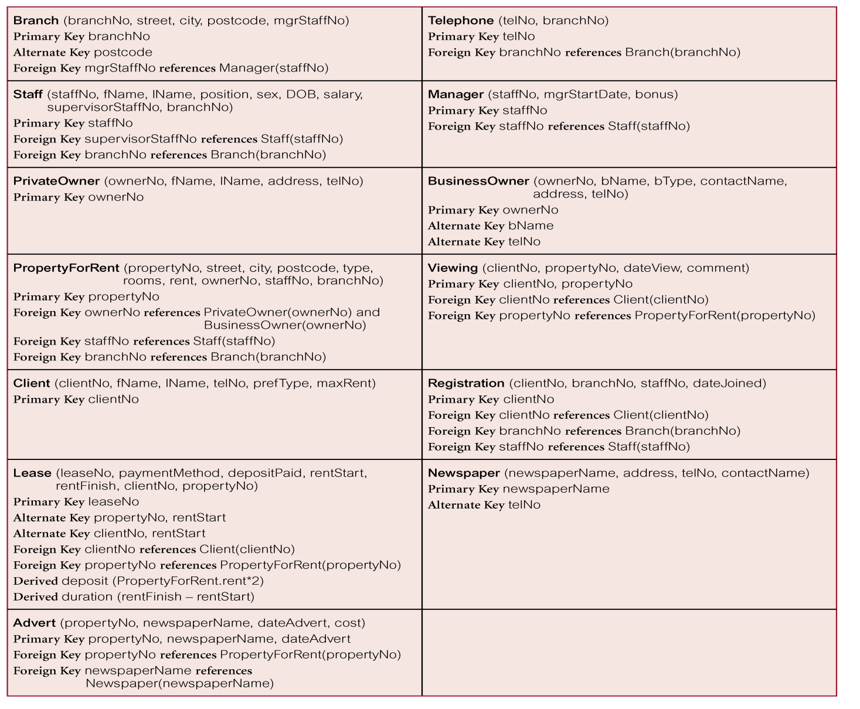
Relations that represent the global logical data model for DreamHome

Slide 43
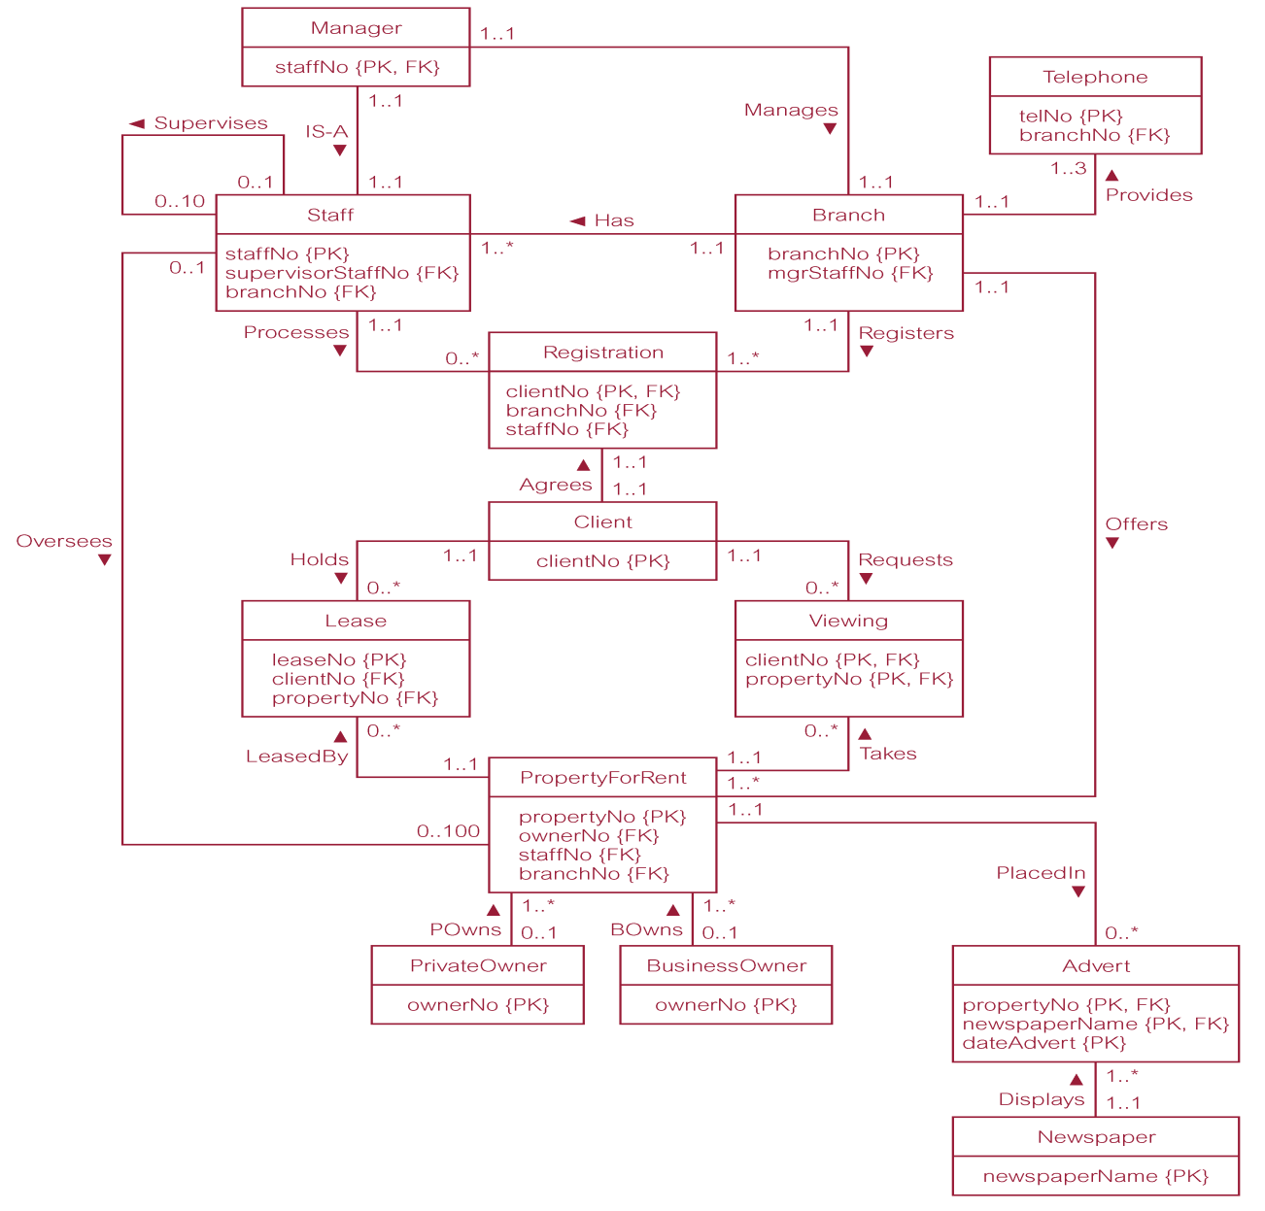
Global relation diagram for DreamHome

